Slide 1
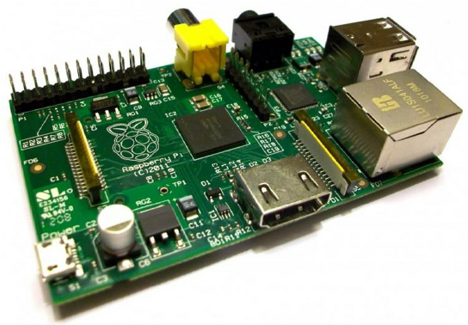
Introduction to Raspberry PI CSE360-Computer Interfacing BRAC University

Slide 2
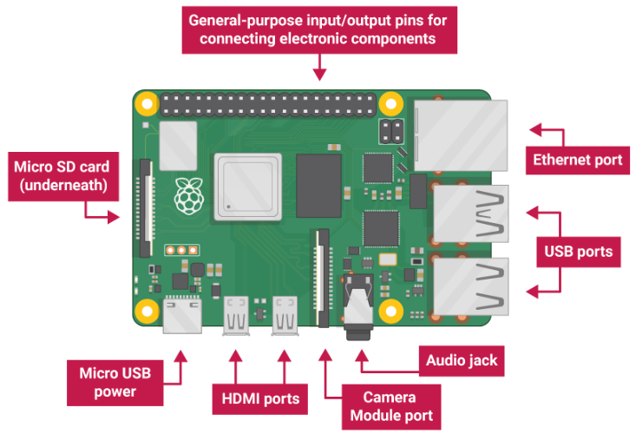
Raspberry Pi

Slide 3
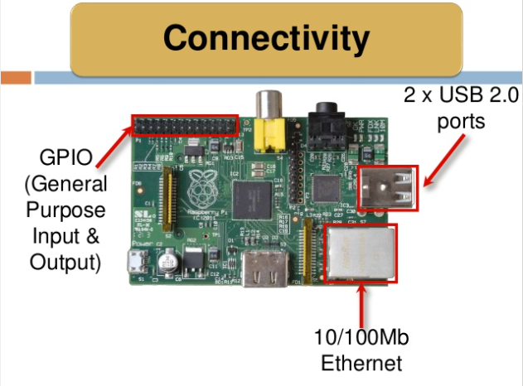

Slide 4
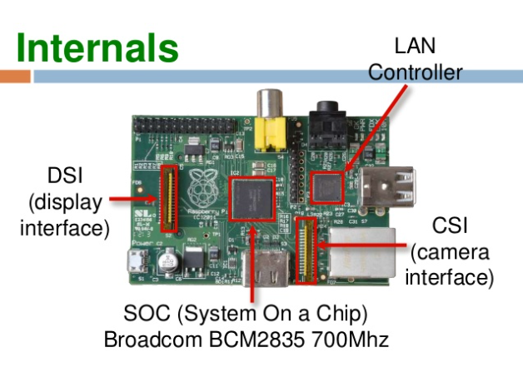

Slide 5
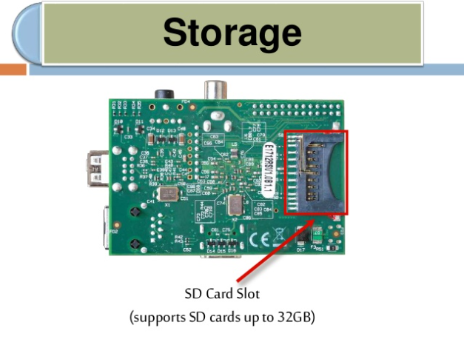

Slide 6
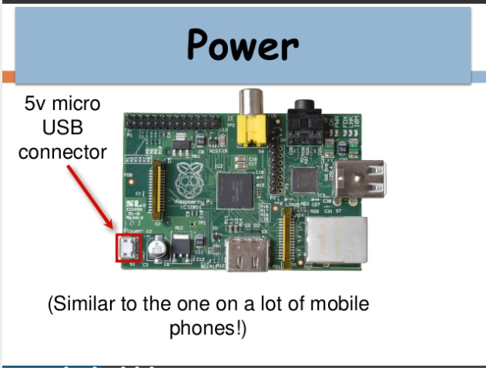

Slide 7
Applications of Raspberry Pi
Build a Full-Fledged Desktop Computer
Home Automation System
Build a Smart TV
Raspberry Pi WiFi Extender
Raspberry Pi Distance Sensor
Motion Capture Security System
Raspberry Pi NAS File Server
Minecraft Game Server
Make a Pi Twitter Bot
Build a TOR router
Network Monitoring Tool
Raspberry Pi as a VPN server
Build An AI Assistant
Wireless Print Server
Weather Station with Raspberry Pi
FM Radio Station

Slide 8
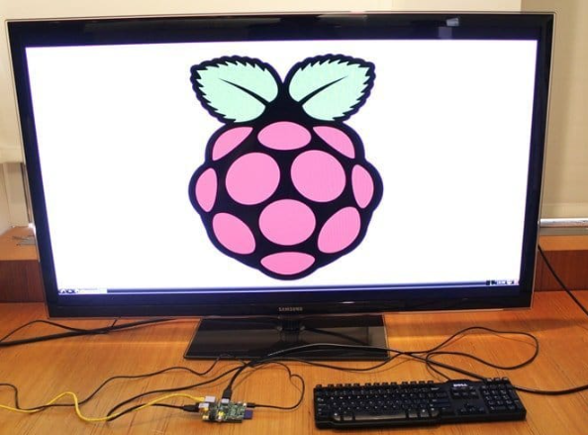
Build a Full-Fledged Desktop Computer

Slide 9

Home Automation System

Slide 10
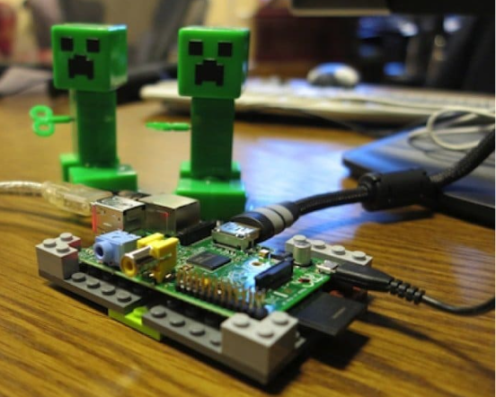
Minecraft Game Server

Slide 11
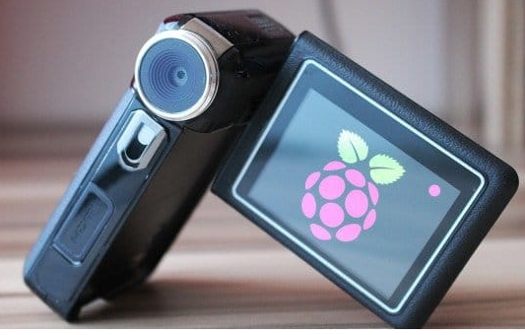
Motion Capture Security System

Slide 12
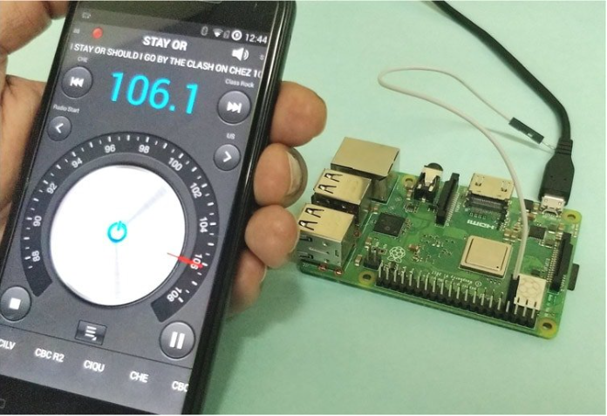
FM Radio Station

Slide 13
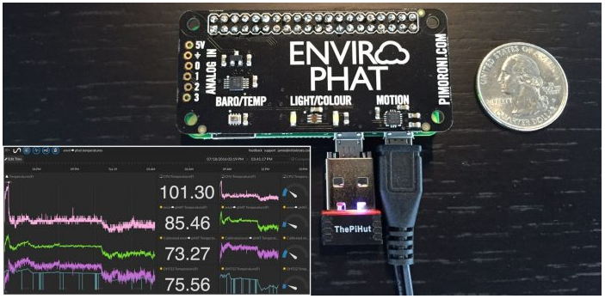
Weather Station with Raspberry Pi

